Slide 1
Testing Python Projects in Data Sciences
H V Nguyen

Slide 2
Agenda

Slide 3
CI/CD in Data Sciences
Continuous Integration
Continuous Delivery
Continuous Deployment
Build
Test
Merge
Automatic Release to Repository
Automatic Deployment to Production
CI/CD Data Sciences
Repeatable envs
Repeatable data
Tested algorithms
Actionable insights
Containerized data
Catalogued algorithms
Productionable Insights
Monetized services
Insight-based decision-making
Audit/ Compliance
Concerns
“Vetted” source of data
Tested algorithms
Secured repository from malicious attack
Insights traceable back to algorithms, learning data, etc.
Engineering code not maliciously deployed
Engineering code not deployed by unauthorized personnel

Slide 4
CI/CD Ecosystem
Continuous Integration
Continuous Delivery
Continuous Deployment
Code & Commit
Build & Config
Scan & Test
Release
Deploy

Slide 5
PEP-8 and Code Analysis

Slide 6
Unit Testing

Slide 7
Integration Testing

Slide 8
Acceptance Testing

Slide 9
References

Slide 10
What Next?
Considerations for Machine Learning
ML is (especially) hard
(Seemingly) random range of “almost”-correct equilibrium (end) states
Solutions? Write Tests
Subtle, Case-specific Problems? Write (more) Tests
Generative Learner? Generative training/test algo/data
Discriminative Learner? SGD (gradient step, loss min., etc.)
Approaches
Model Assertions (running and training time)
Runtime monitoring, Corrective action, Active Learning, Weak Supervision
Debugging Tasks
Classification (training data), Root cause (Pearl’s Probability of Sufficiency), etc.

Slide 11

Question & Answer

Slide 12
References
Cadamuro G., et. al. (Preprint) “Debugging Machine Learning Models”, University of Washington
Chakarov A. et.al. 2016 “Debugging Machine Learning Tasks”, University of Colorado
Cohen W. (Presentation) “Debugging Machine Learning Algorithms” CMU (http://www.cs.cmu.edu/~wcohen/10-605/debugging-tips.pdf )
Kang D. et.al. (Preprint) “Model Assertions for Debugging Machine Learning”, Stanford DAWN Project

Slide 13
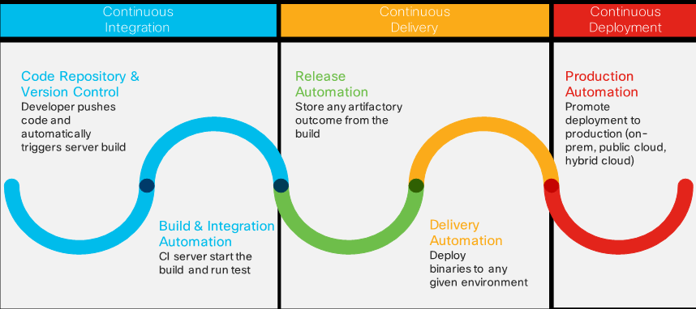
CI/CD

Slide 14
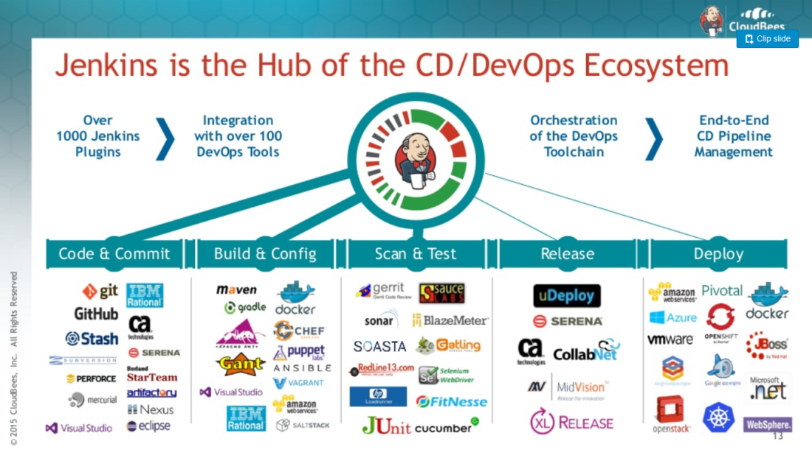

Slide 15
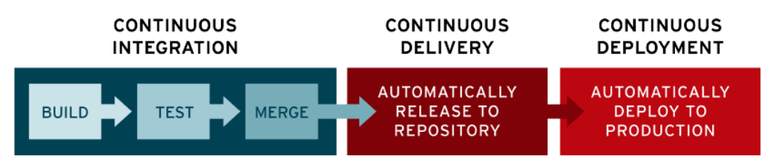
Red Hat

